Slide 1
Customer Shopping Behavior Analysis (2021–2023)
Gender, Age, Category & Payment Insights
Prepared by: Akshay Rathod and Vinayak Chaudhari
Project ID:PTID-CDA-DEC-25-970
Tool Used: Power BI

Slide 2
PROJECT OVERVIEW
Objective of the Project
To analyze customer shopping behavior across gender and age group
To understand shopping distribution by gender and age group
To identify top-performing product categories
To study payment method preferences and their relationship with customer demographics
To derive actionable business insights for decision-making
Dataset Overview
Time Period: 2021 – 2023
Data Source: Shopping malls in Istanbul
Dataset includes:
Customer demographics (Gender, Age)
Product categories
Quantity & Revenue
Payment methods
Shopping mall locations
Tools Used
Power BI – Data Modeling & Dashboarding
DAX – KPI & Measure calculations

Slide 3
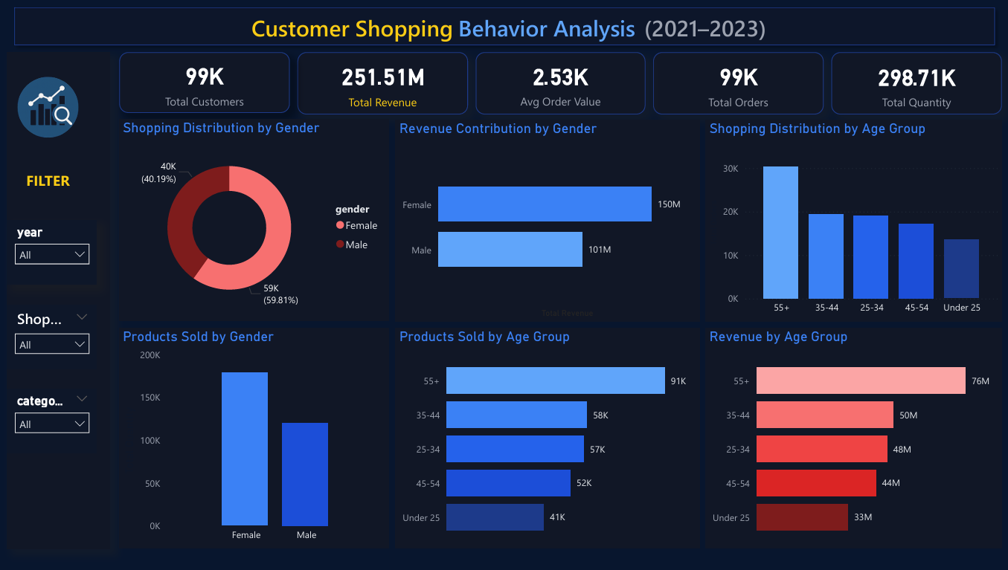
DASHBOARD PAGE 1 – CUSTOMER OVERVIEW
KPIs Covered:
Total Customers
Total Revenue
Average Order Value
Total Orders
Total Quantity Sold
Dashboard Focus
Overall business performance using KPIs
Shopping distribution by gender
Shopping distribution by age group
Products sold and revenue generated across demographics
This page answers gender-wise and age-wise shopping distribution, product sales, and revenue contribution

Slide 4
KEY INSIGHTS – GENDER & AGE ANALYSIS (PAGE 1)
Gender-based Insights
Shopping distribution shows a slightly higher participation from female customers
Female customers purchase more products compared to male customers
Female customers also generate higher total revenue
The 55+ age group contributes the highest revenue and product quantity
Middle-aged and older customers show higher purchasing power
Younger age groups contribute comparatively lower revenue
Age Group Insights
Business Insight
Older customers are more valuable in terms of order size and revenue contribution
Key Observation
Customer purchasing behavior varies significantly across gender and age segments

Slide 5
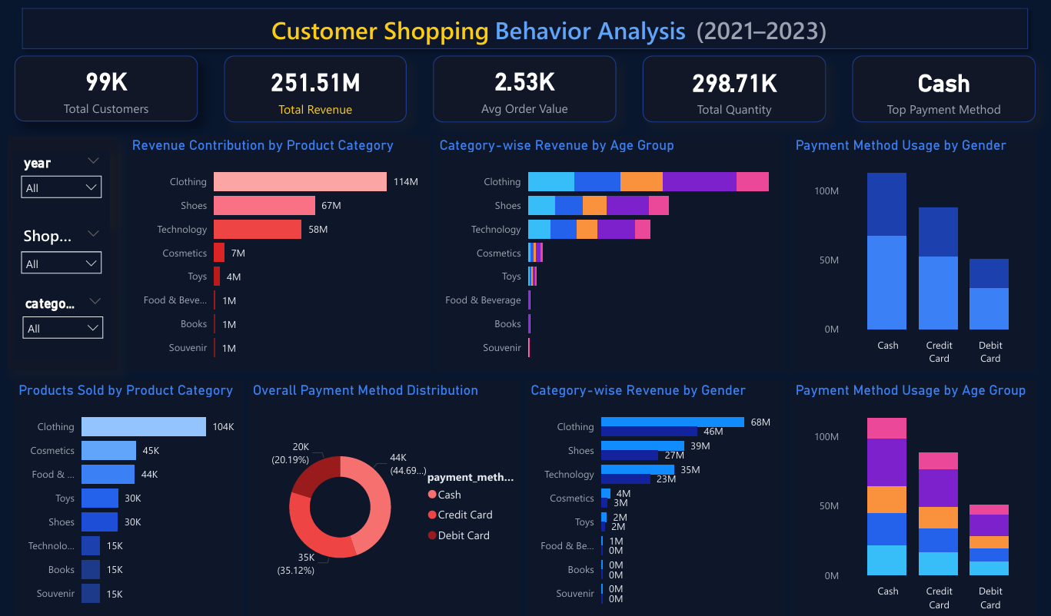
DASHBOARD PAGE 2 – CATEGORY & PAYMENT ANALYSIS
Analysis Areas:
Revenue by Product Category
Products Sold by Category
Payment Method Distribution
Payment Method usage by Gender & Age Group
Dashboard Focus
Product category performance by revenue and quantity
Category distribution across gender and age groups
Payment method distribution
Relationship between payment methods and demographics
This page explains category distribution relative to gender and age, and payment method relationships

Slide 6
KEY INSIGHTS – PAGE 2
Product Category Insights
Clothing is the highest revenue-generating category
Shoes and Technology are strong secondary contributors
Categories such as Books and Souvenirs contribute relatively less revenue
Category preference varies across different age groups and genders
Payment Method Insights
Cash is the most preferred payment method overall
Credit card usage is high among middle-aged customers
Payment preferences vary by age group and gender, indicating a clear relationship
Category and payment preferences show strong relationships with customer demographics

Slide 7
BUSINESS RECOMMENDATIONS
Focus marketing efforts on high-value age groups such as 35+ and 55+
Prioritize promotions and inventory for top
performing categories like Clothing and Shoes
Encourage digital payments by offering incentives for card usage
Use demographic-category insights to design targeted marketing campaigns
Improve customer retention through personalized offers
Use insights from category and demographic analysis to improve targeted marketing and promotions

Slide 8
CONCLUSION
The Power BI dashboard successfully addresses all 11 business tasks
Customer behavior shows clear variation by gender, age, category, and payment method
Insights derived from the dashboard support data-driven decision-making
The dashboard successfully addresses all 11 business questions through interactive visual analysis
Thank You

